Slide 1

Bayesian Belief Networks to Predict Software Defects
M. Haneesh – 554
G. Manas - 533
G. Ramesh - 534

Slide 2
Contents
Objective Of Project
Introduction to Software Defects
Introduction to Bayesian Network
Bayesian Network Models
System Requirement Specification
Confusion Matrix
Screen Shots
Results
Future Enhancement
Conclusion
References

Slide 3
Objective of Project
This project reviews the use of Bayesian networks (BNs) in predicting software defects which is identifying error prone software modules referred to as software defect prediction.

Slide 4
Software Defects
A software defect is a deficiency in a software product that causes it to perform unexpectedly.
From a software user’s perspective, a defect is anything that causes the software not to meet their expectations.
A software user can be either a person or another piece of software.

Slide 5
Software Defects Example
User Expectation | Software Defects
The software will help me accomplish a task | Desired software functionality is missing
Clicking on the button performs the task I want to do | Clicking on the button does nothing or not what I want it to do
A file can be successfully copied to another location | The file becomes corrupted during the copy process
Calling a method in the API will perform as documented | The API fails due to an undocumented change to the registry

Slide 6
Bayesian Network
A Bayesian network is a directed acyclic graph (DAG), composed of E edges and V vertices which represent joint probability distribution of a set of variables.
V = Vertex which represents random variable
E = Edge which represents Conditional Dependency between the variable and its successor variable.
Let X = { X₁ , X₂ , ... X_{n} } be n variables taking continuous or discrete values. The probability distribution of X_{i} is shown as P( X_{i} |a _{xi} ) where a_{xi} ’s represent parents of X_{i} if any. When there are no parents of X_{i} , then it is a prior probability distribution and can be shown as P( X_{i} ).

Slide 7
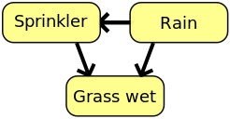
Example
A simple Bayesian network. Rain influences whether the sprinkler is activated, and both rain and the sprinkler influence whether the grass is wet.

Slide 8
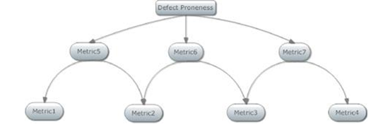
Application of BN to predict Software Defect
Many methods for software defect prediction but accuracy of specific algorithm depends on attributes of data set.
Important to model relationships among Metrics and Defect proneness. Two results are obtained.

Slide 9
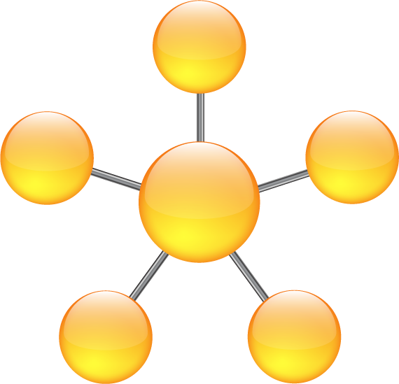
Bayesian Network Models
Naïve Bayes Model
Markov Blanket
Markov Random Field

Slide 10
Naïve Bayes Model
A Naïve Bayes classifier is a simple Probabilistic Classifier with strong independence assumptions.
It assumes that the presence or absence of a particular feature is unrelated to the presence or absence of any other feature, given the class variable.
It requires a small amount of training data to estimate the parameters necessary for classification.
Because independent variables are assumed, only the variances of the variables for each class need to be determined and not the entire covariance matrix.

Slide 11


Naïve Bayes Model (cont..)
The probability model for a classifier is a conditional model
C = Class Variable with small no of outcomes
F1…Fn = Feature Variables
When n is large, probability table is infeasible and hence it is written using Bayes theorem,
=
In practice, denominator ignored as it doesn’t depend on C and F(i) values given so that it is effectively constant.

Slide 12
System Requirement Specification
SOFTWARE REQUIREMENTS:
Operating System : Windows 2000
Tool : BayesiaLab
HARDWARE REQUIREMENTS:
Processor : Pentium IV
Clock Speed : 2.86GHZ Processor
Hard disk : 2GB
RAM : 256MB

Slide 13
Markov Blanket
In machine learning, the Markov blanket for a node A in a Bayesian network is the set of nodes composed of A's parents, its children, and its children's other parents. A Markov blanket may also be denoted by . MB(A)
Every set of nodes in the network is conditionally independent of A when conditioned on the set , that is, when conditioned on the Markov blanket of the node A.
The probability has the Markov property; formally, for distinct nodes and :

Slide 14
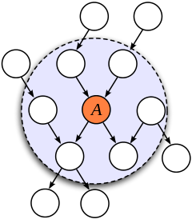
Markov Blanket (cont..)
In a Bayesian network, the Markov blanket of node A includes its parents, children and the other parents of all of its children.

Slide 15
Markov Blanket (Cont..)
The Markov blanket of a node contains all the variables that shield the node from the rest of the network.
This means that the Markov blanket of a node is the only knowledge needed to predict the behavior of that node.
In a Bayesian network, the values of the parents and children of a node evidently give information about that node.
However, its children's parents also have to be included, because they can be used to explain away the node in question.

Slide 16
Confusion Matrix
A confusion matrix contains information about actual and predicted classifications done by a classification system. Performance of such systems is commonly evaluated using the data in the matrix.
The entries in the confusion matrix have the following meaning in the context of our study:
 |  | Predicted
Actual |  | Negative | Positive
 | Negative | TN | FN
 | Positive | FP | TP

Slide 17
Confusion Matrix
The number of correct predictions that an instance is negative = TN
The number of incorrect predictions that an instance is positive =FN
The number of incorrect of predictions that an instance negative = FP
The number of correct predictions that an instance is positive = TP
Accuracy = TN+TP / TP + TN + FP + FN
Sensitivity = TP / TP + FN
Specificity = TN / TN+ FP

Slide 18
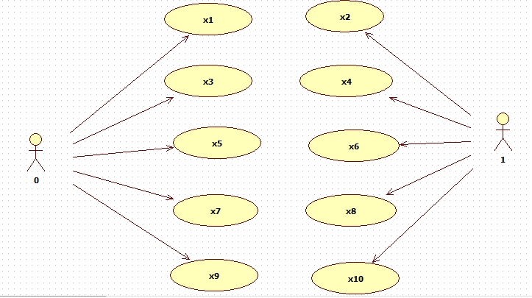
Use Case Diagram

Slide 19
Markov Random Field
Set of random variables having a Markov property described by an undirected graph.
Similarity and Difference between MRF and BBN.
Markov network can represent certain dependencies that a Bayesian network cannot on the other hand for example, Cyclic Dependencies.
It can't represent certain dependencies that a Bayesian network can such as induced dependencies.

Slide 20
Markov Random Field (Cont..)
Given an undirected graph G = (V, E), a set of random variables X = (X_{v})_{v ∈ V} indexed by V form a Markov random field with respect to G if they satisfy the local Markov properties:
Pairwise Markov property: Any two non-adjacent variables are conditionally independent given all other variables:
Local Markov property: A variable is conditionally independent of all other variables given its neighbors:
where ne(v) is the set of neighbors of v, and cl(v) = {v} ∪ ne(v) is the closed neighbourhood of v.
Global Markov property: Any two subsets of variables are conditionally independent given a separating subset:

Slide 21
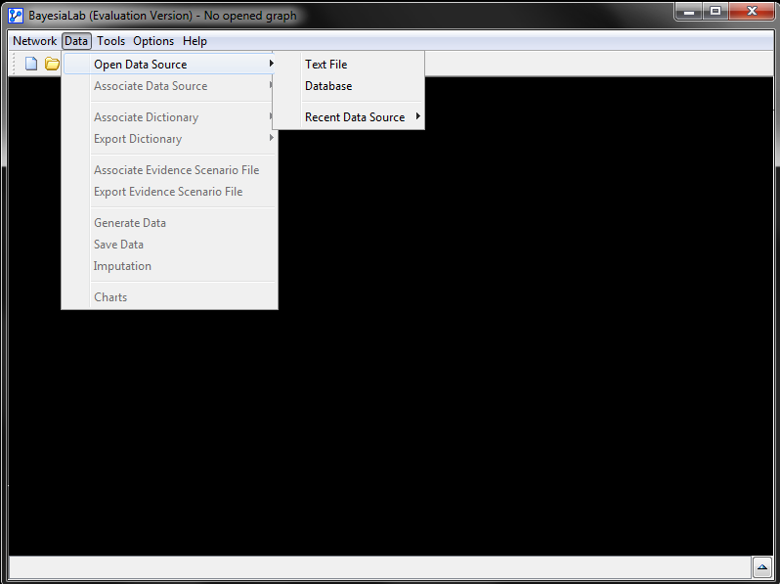

Slide 22
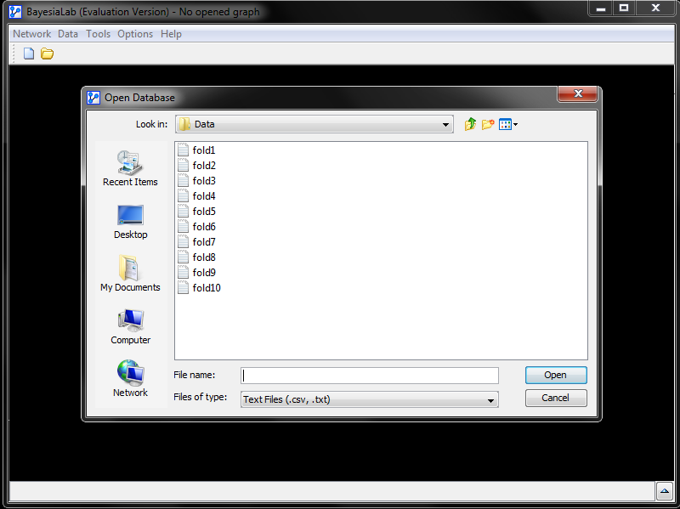

Slide 23
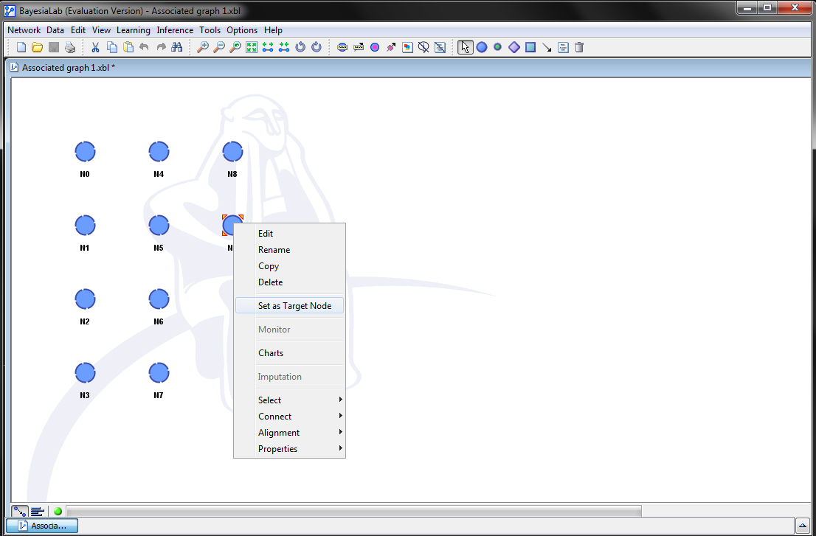

Slide 24
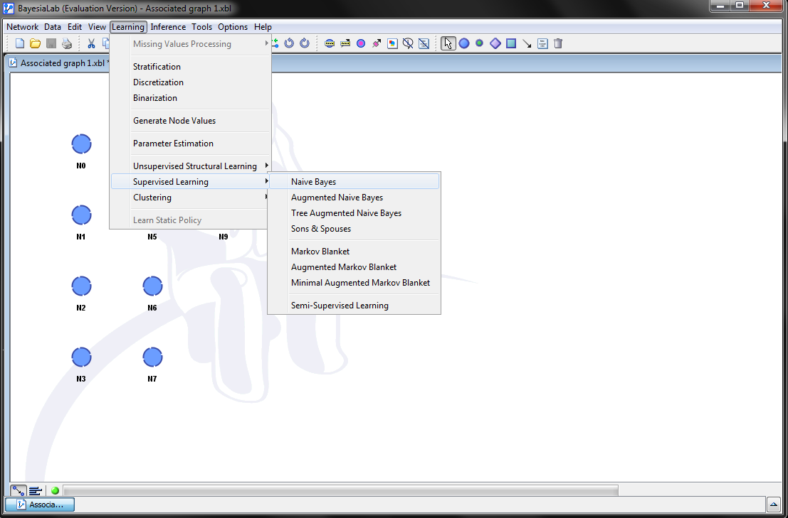

Slide 25
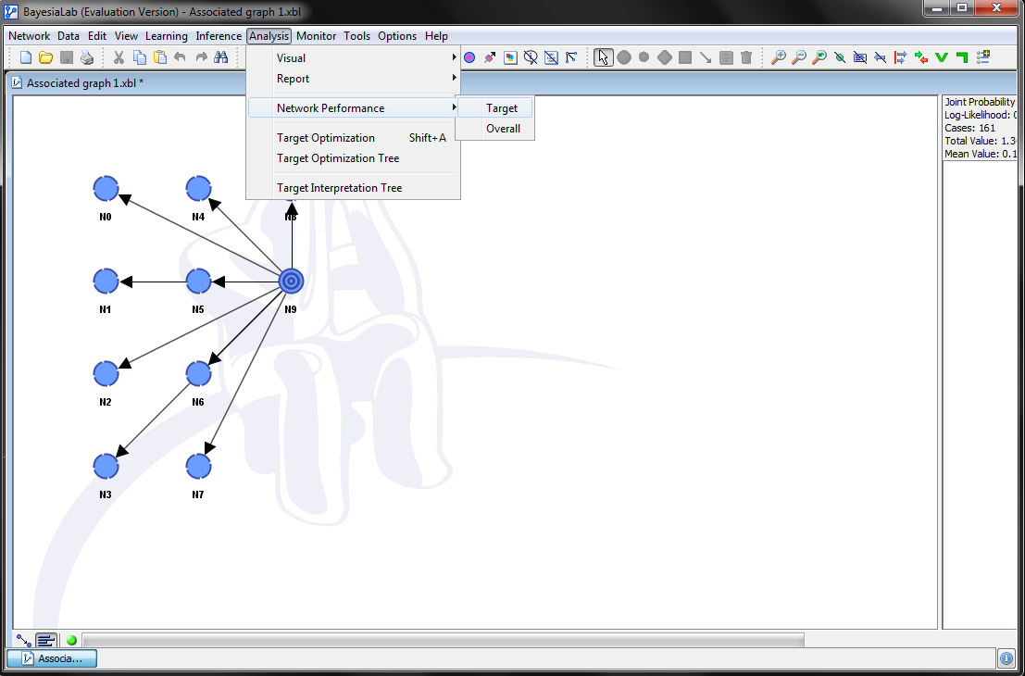

Slide 26
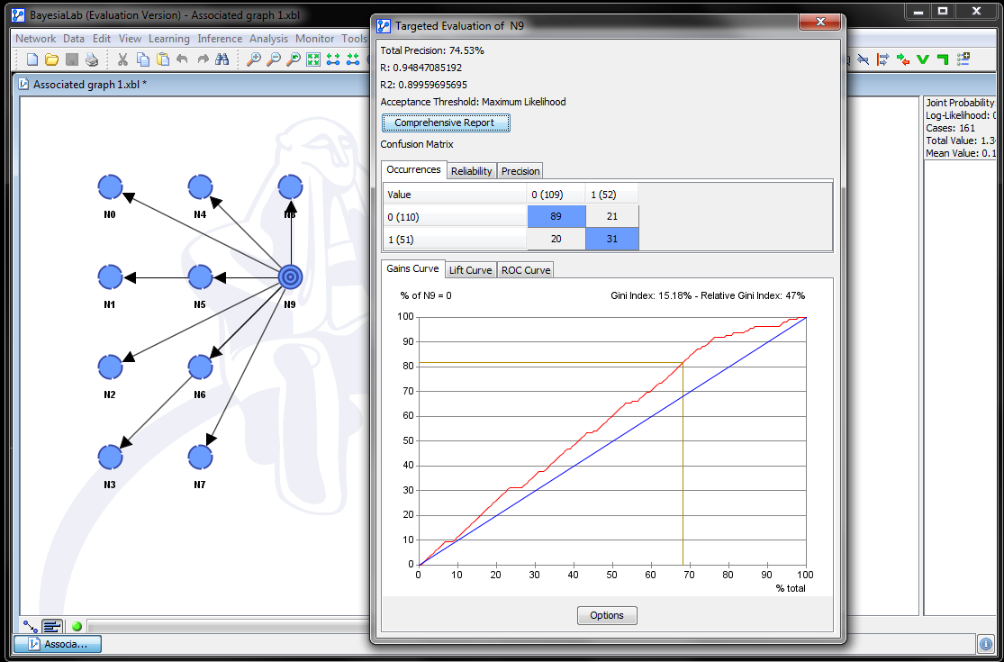

Slide 27
Results – Naïve Bayes
 | Sensitivity | Specificity | Accuracy
FOLD 1 | 80 | 58 | 73
FOLD 2 | 80 | 58 | 73
FOLD 3 | 81 | 59 | 73
FOLD 4 | 80 | 57 | 72
FOLD 5 | 80 | 55 | 78
FOLD 6 | 77 | 57 | 70
FOLD 7 | 79 | 60 | 72
FOLD 8 | 80 | 60 | 71
FOLD 9 | 80 | 57 | 74
FOLD 10 | 79 | 60 | 72
Average | 79.6 | 58.1 | 72.8

Slide 28
Results – Markov Blanket
 | Sensitivity | Specificity | Accuracy
FOLD 1 | 78 | 57 | 72
FOLD 2 | 78 | 57 | 72
FOLD 3 | 78 | 57 | 72
FOLD 4 | 74 | 70 | 75
FOLD 5 | 78 | 57 | 72
FOLD 6 | 74 | 68 | 73
FOLD 7 | 78 | 57 | 72
FOLD 8 | 78 | 57 | 72
FOLD 9 | 78 | 57 | 72
FOLD 10 | 76 | 56 | 71
Average | 77 | 59.3 | 72.3

Slide 29
Results – Augmented Markov Blanket
 | Sensitivity | Specificity | Accuracy
FOLD 1 | 78 | 57 | 72
FOLD 2 | 78 | 56 | 71
FOLD 3 | 77 | 57 | 72
FOLD 4 | 68 | 0 | 68
FOLD 5 | 74 | 70 | 73
FOLD 6 | 78 | 57 | 72
FOLD 7 | 78 | 57 | 72
FOLD 8 | 78 | 57 | 72
FOLD 9 | 78 | 57 | 72
FOLD 10 | 68 | 0 | 68
Average | 75.5 | 46.8 | 71.2

Slide 30
Future enhancement
To predict software defects more precisely, many more intelligent techniques apart from BBN can be employed viz. PNN, GRNN, J48, TreeNet and CART etc.
Further, their ensemble approach can also be applied to software defects to get more accurate results.

Slide 31
Conclusion
In this project, we employed Bayesian Belief Networks to predict software defects.
From the experiment, we found the average sensitivity of 79.6%, average specificity of 58.1% and average accuracy of 72.8% by using Naïve Bayes Supervised Learning method.
The average sensitivity of 77%, average specificity of 59.3% and average accuracy of 72.3% by using Markov Blanket Supervised Learning method and also
The average sensitivity of 75.5%, average specificity of 46.8% and average accuracy of 71.2% by using Augmented Markov Blanket Supervised Learning method.
This is the outcome of our study. From this simulation study, we are be able to predict if a software project is having a defect or not.

Slide 32
References
[1] Alpaydın E (2004) Introduction to machine learning. The MIT Press, Cambridge, MA
[2] Amasaki S, Takagi Y, Mizuno O, Kikuno T (2003) A bayesian belief network for assessing the likelihood of fault content. In: Proceedings of the 14th international symposium on software reliability engineering, ISSRE ’03. IEEE Computer Society, Washington, DC
[3] Bibi S, Stamelos I (2004) Software process modeling with bayesian belief networks. In: Proceedings of 10th international software metrics symposium
[4] Boetticher G, Menzies T, Ostrand T (2007) Promise repository of empirical software engineering data http://promisedata.org/ repository. Department of Computer Science, West Virginia University
[5] Boetticher GD (2005) Nearest neighbor sampling for better defect prediction. In: Proceedings of the 2005 workshop on predictor models in software engineering, PROMISE ’05
[6] Chidamber SR, Kemerer CF (1991) Towards a metrics suite for object oriented design. SIGPLAN 26(11):197–211
[7] Cooper GF, Herskovits E (1992) Abayesian method for the induction of probabilistic networks from data. Mach Learn 9(4):309–347
[8] Dejaeger K, Verbraken T, Baesens B (2012) Towards comprehensible software fault prediction models using bayesian network classifiers. IEEE Trans Softw Eng 99:1. doi:10.1109/TSE.2012.20

Slide 33
Thank You

